Slide 1
ANLY 590
Artificial Neural Networks and Deep Learning

Slide 2
Outline
Overview of Recent Excitement in Deep Learning
Administrative Topics
Assignments, Exams, Projects, Grading
Course style
Prerequisite knowledge
Major course topics

Slide 3
Deep Learning Successes

Slide 4
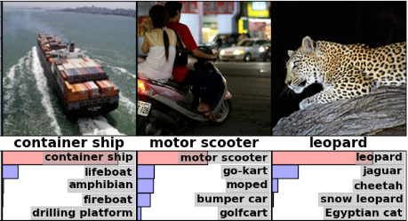
Image Analysis
https://papers.nips.cc/paper/4824-imagenet-classification-with-deep-convolutional-neural-networks.pdf

Slide 5
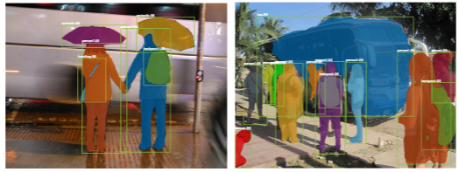
Image Analysis
https://arxiv.org/pdf/1703.06870.pdf

Slide 6

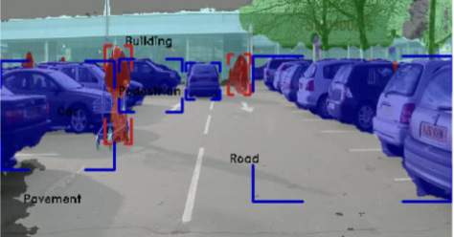
Image Analysis
https://arxiv.org/pdf/1611.08303.pdf
https://arxiv.org/pdf/1707.02432.pdf

Slide 7
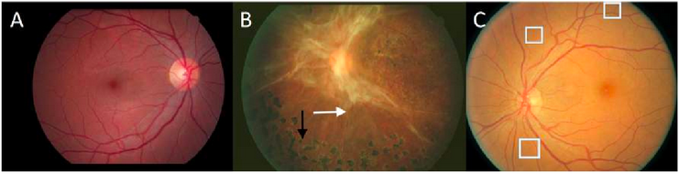
Image Analysis
https://www.healthcarefinancenews.com/news/fda-approves-first-ai-tool-detecting-retinopathy-nih-shows-machine-learning-success-imaging
https://jamanetwork.com/journals/jama/fullarticle/2588763
https://www.semanticscholar.org/paper/Automated-Detection-of-Diabetic-Retinopathy-using-Lam-Yi/e9fbe155954c01560d8e2504741692a40e3ffa31

Slide 8
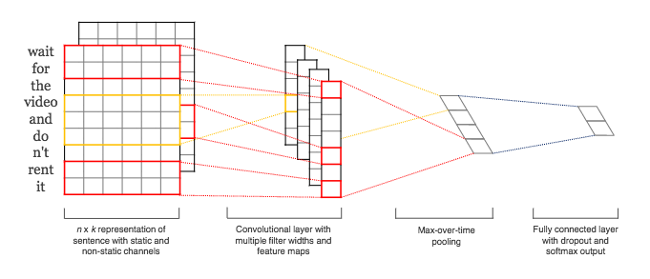
NLP - Sentence Classification
http://www.aclweb.org/anthology/D14-1181

Slide 9
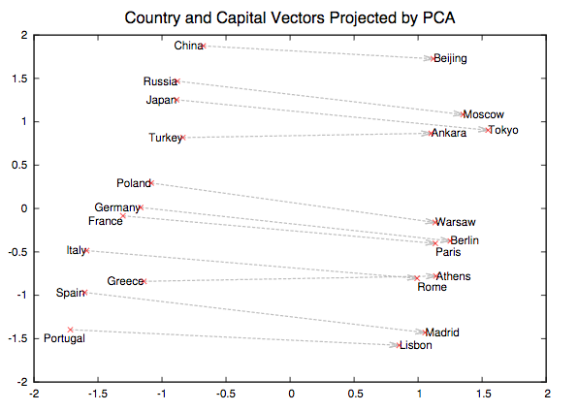
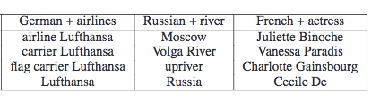
NLP - Word Embeddings
https://papers.nips.cc/paper/5021-distributed-representations-of-words-and-phrases-and-their-compositionality.pdf

Slide 10
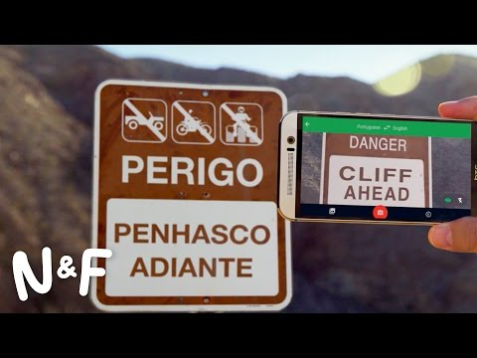
NLP - Machine Translation

Slide 11
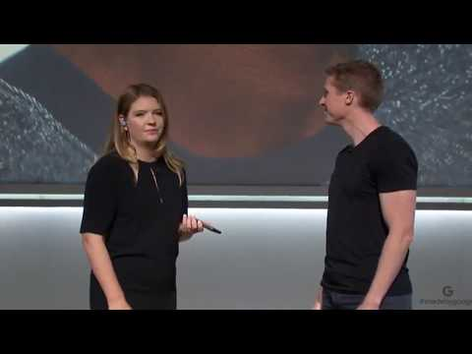
NLP - Machine Translation

Slide 12
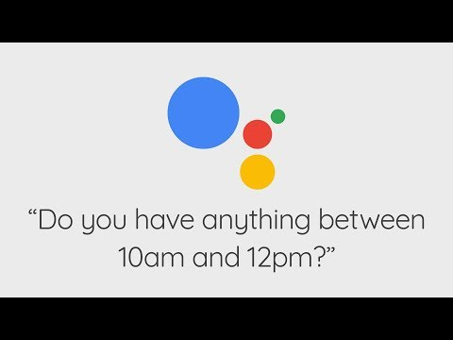
NLP - Natural Language Understanding

Slide 13

Reinforcement Learning - Atari Games

Slide 14
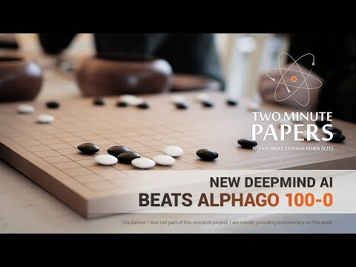
Reinforcement Learning - AlphaGo

Slide 15
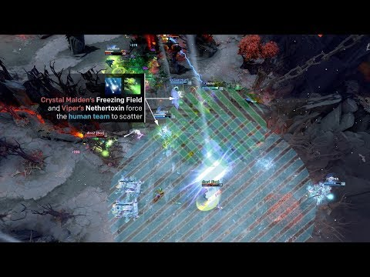
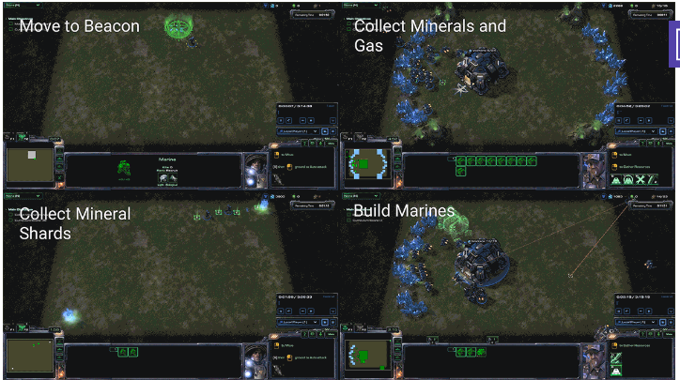
Reinforcement Learning - StarCraft and Dota
https://deepmind.com/blog/deepmind-and-blizzard-open-starcraft-ii-ai-research-environment/
https://github.com/Blizzard/s2client-proto
https://blog.openai.com/openai-five/

Slide 16
Course Logistics

Slide 17
Administrative
Course Location: Car Barn 172
Course Meeting time: 6:30 PM Tues for Section 02 and Thurs for Section 01
Office Hours: Will be available prior to class each week. Send an email in advance to let me know you are interested in meeting.
Class Content: Each week will be a mix of lecture, guided coding examples, and small group exercises.
Expected Etiquette: Laptops and phones are to be put away while lectures are delivered. Laptops are only to be brought out during group work. Students are expected to be respectful and attentive, especially when their peers are presenting

Slide 18
Course Work
Assignments
There will be 4-5 graded assignments/projects
These will be a combination of theory and coding projects
Assignments will be turned in electronically
Midterm
There will be an in-class Midterm Exam. You will be expected to be able to derive and interpret relevant equations, reason about core concepts, interpret model outputs etc
Final Project
See next slide
There will be no final exam

Slide 19
Final Project
The culmination of the course will be a group project
You will work in groups of 2-4 people
You will devise a project of your own choosing to apply course concepts to any task or dataset that is of interest to you
Your major deliverable will be a scientific poster for our course Poster Session at the end of the semester
Your group will also complete a write-up of your work and results
Project Milestones
Oct 15: Finalize your group members and write project proposal
Nov 1: Identify data sets used and methods proposed
Week of Nov 13: Project Check-Ins
Week of Dec 6: Poster Session
Dec 12: Deadline to turn in write-up and repo

Slide 20
Github
Each of you will use a Github repo to track and submit your coursework
Learning git and github can be a little tricky, but has important benefits
1. The tech world uses github, it’s time to learn
2. Version controlling (and collaborating) your coding work is the smart thing to do
3. At the end of our course, you will have a public portfolio of machine learning projects you have completed. This will aid in job search and interviews. More generally, this helps to inform the world about what you’re interested in and knowledgeable about.
Git tutorials
https://www.dataschool.io/git-and-github-videos-for-beginners/
https://s3.amazonaws.com/anly-590/git-for-anly590.mov

Slide 21
Course Topics

Slide 22
Generative Adversarial Networks
Feedforward Networks
Convolutional Networks
Recurrent Networks
Reinforcement Learning
Backprop and Inference
Deep Learning Toolkits
Unsupervised Deep Learning
Guest Topics

